Slide 1
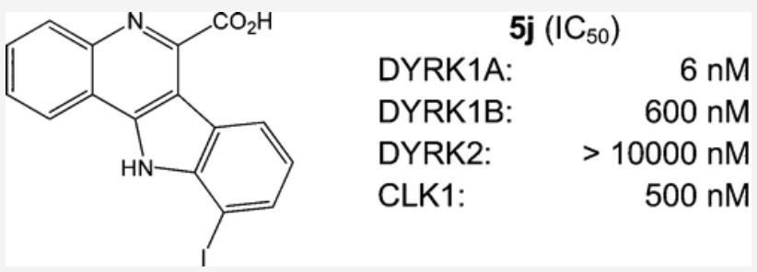
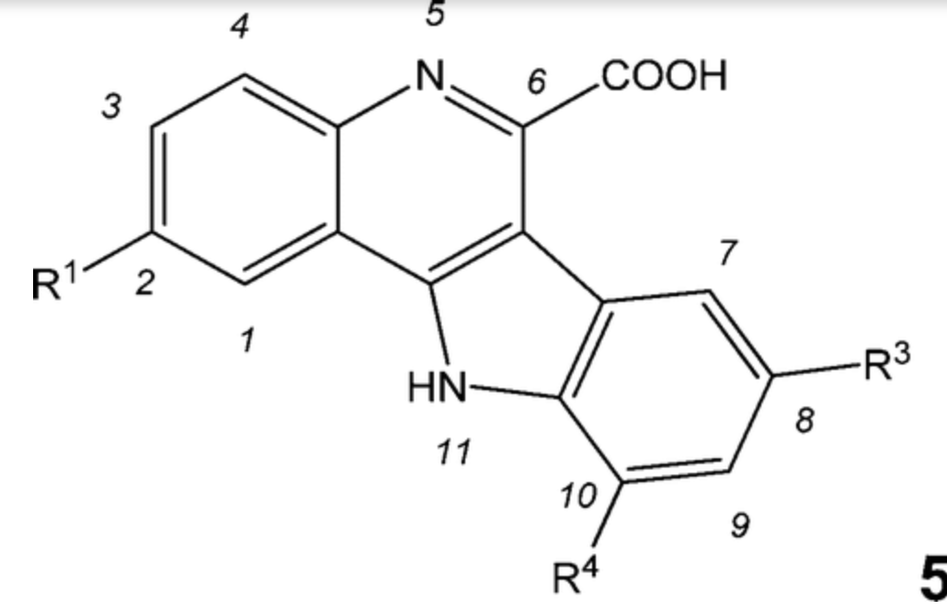
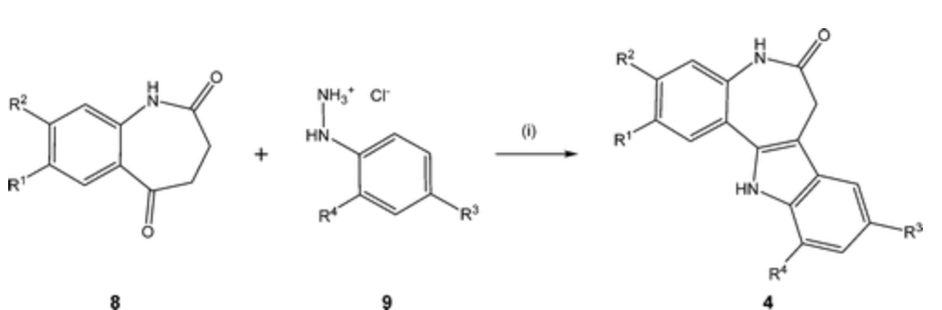
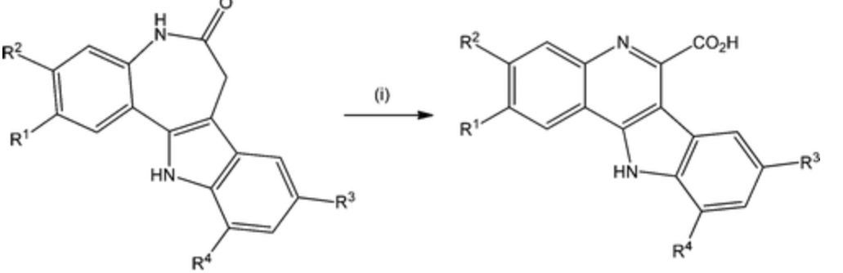
10-Iodo-11H-indolo[3,2-c]quinoline-6-carboxylic Acids Are Selective Inhibitors of DYRK1A
In collaboration with Stefan Knap (SGC Frankfurt!!!)
Conrad Kunick; Technische Universität Braunschweig
Journal of Medicinal Chemistry (2015), 58(7), 3131-3143.
c.kunick@tu-braunschweig.de

Slide 2
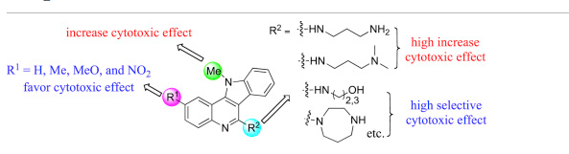
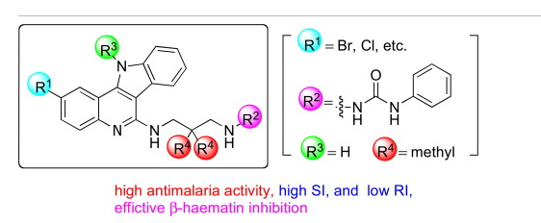
Synthesis and in vitro cytotoxic effect of 6-amino-substituted 11H- and 11Me-indolo[3,2-c]quinolines
European Journal of Medicinal Chemistry (2014), 78, 314-323.
Synthesis, β-haematin inhibition, and in vitro antimalarial testing of isocryptolepine analogues: SAR study of indolo[3,2-c]quinolines with various substituents at C2, C6, and N11
Bioorganic & Medicinal Chemistry (2014), 22(9), 2629-2642
Tsutomu Inokuchi; Okayama University; Japan
inokuchi@cc.okayama-u.ac.jp

Slide 3
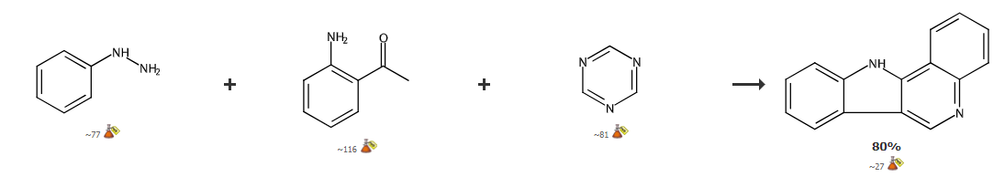
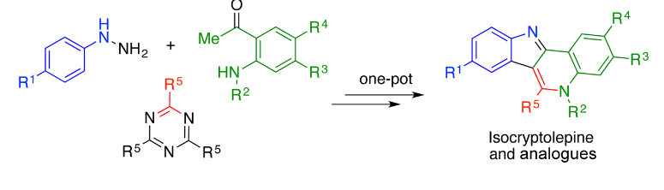
One-Pot, Three-Component Assembly of Indoloquinolines: Total Synthesis of Isocryptolepine
Michael Rubin; University of Kansas
J. Org. Chem. 2017, 82, 6, 3011–3018

Slide 4

Rapid Synthesis of Fused N‐Heterocycles by Transition‐Metal‐Free Electrophilic Amination of Arene CH Bonds
Prof. László Kürti; University of Texas
Angewandte Chemie. , 2014, Vol.53(10), p.2701-2705
laszlo.kurti@utsouthwestern.edu

Slide 5
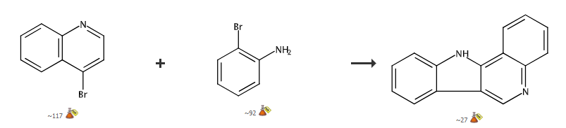
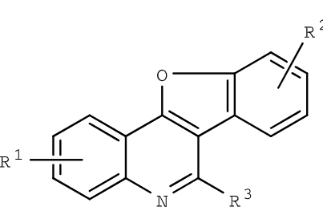
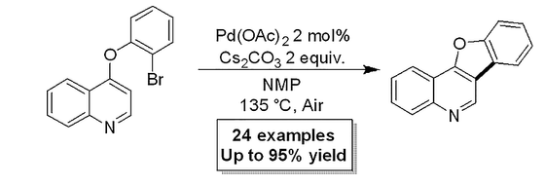
Synthesis of Benzofuroquinolines via Phosphine-Free Direct Arylation of 4-Phenoxyquinolines in Air
Gerard P. McGlacken (University College Cork, Cork, Ireland)
European Journal of Organic Chemistry, 2018(44), 6140-6149; 201
g.mcglacken@ucc.ie
http://research.ucc.ie/profiles/D004/gmcglacken

Slide 6
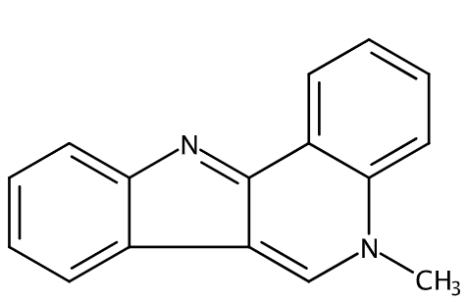
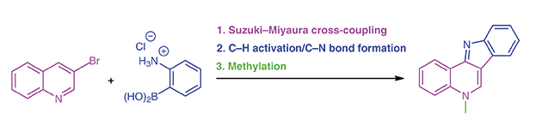
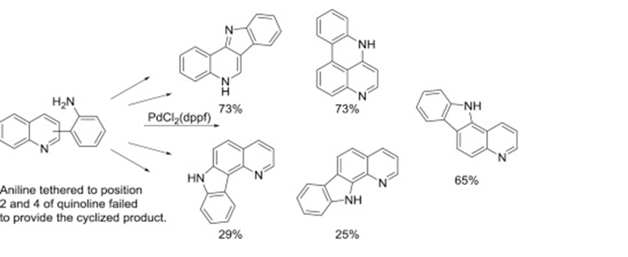
A Concise Synthesis of Isocryptolepine by C-C Cross-Coupling Followed by a Tandem C-H Activation and C-N Bond Formation
SynOpen (2017), 1, (1), 0041-0044
Mapping the reactivity of the quinoline ring-system – Synthesis of the tetracyclic ring-system of isocryptolepine and regioisomers
Tetrahedron, 75, 21, 2019, Pages 2949-2957
Magne O. Sydnes, University of Stavanger, Norway
magne.o.sydnes@uis.no

Slide 7
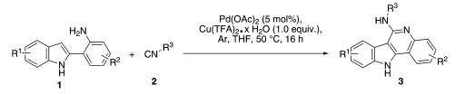
Palladium(II)‐Catalyzed Cycloamidination via C(sp2)H Activation and Isocyanide Insertion
Qiang Zhu; Guangzhou Institutes of Biomedicine and Health; China
Advanced Synthesis & Catalysis (2012), 354(10), 1902-1908
zhu_qiang@gibh.ac.cn

Slide 8
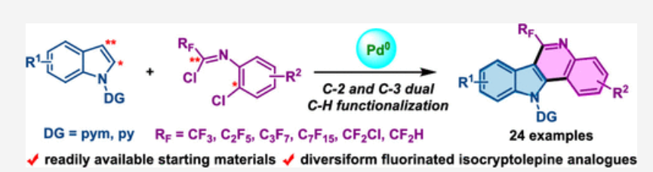
Palladium-Catalyzed C-2 and C-3 Dual C–H Functionalization of Indoles: Synthesis of Fluorinated Isocryptolepine Analogues
Bolin Zhu; Tianjin Normal University, Tianjin; China
Org. Lett. 2020, 22, 11, 4097–4102
hxxyzbl@tjnu.edu.cn

Slide 9
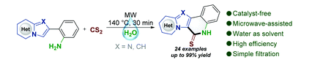
6π-Electrocyclization in water: microwave-assisted synthesis of polyheterocyclic-fused quinoline-2-thiones
Bing Yu; Zhengzhou University, Zhengzhou; China
Green Chemistry (2020), 22(14), 4445-4449
bingyu@zzu.edu.cn

Slide 10
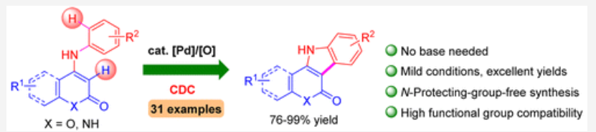
Access to Indole-​Fused Polyheterocycles via Pd-​Catalyzed Base-​Free Intramolecular Cross Dehydrogenative Coupling
Ming-Hua Xu; Shanghai Institute of Materia Medica; China
Journal of Organic Chemistry (2016), 81(22), 11501-11507
xumh@simm.ac.cn

Slide 11
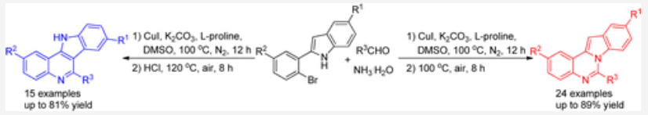
Regioselective Synthesis of Indolo[1,2-c]quinazolines and 11H-Indolo[3,2-c]quinolines via Copper-Catalyzed Cascade Reactions of 2-(2-Bromoaryl)-1H-indoles with Aldehydes and Aqueous Ammonia
Xuesen Fan; Key Laboratory of Green Chemical Media and Reactions; China
xuesen.fan@htu.cn

Slide 12
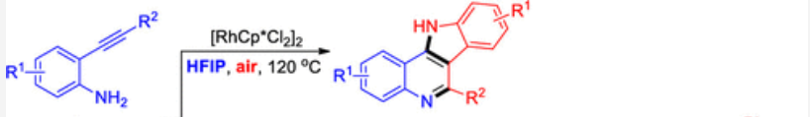
Tunable Synthesis of Indolo[3,​2-​c]​quinolines or 3-​(2-​Aminophenyl)​quinolines via Aerobic​/Anaerobic Dimerization of 2-​Alkynylanilines
Xuesen Fan; Henan Key Laboratory of Organic Functional Molecules and Drug Innovation; China
Organic Letters (2019), 21(13), 4996-5001.
xuesen.fan@htu.cn

Slide 13
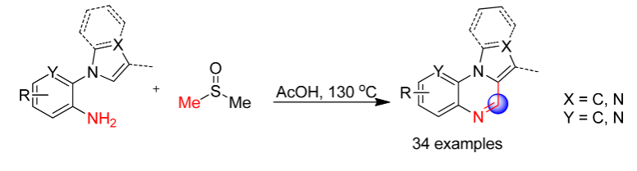
Dimethyl Sulfoxide Involved One-​Pot Synthesis of Quinoxaline Derivatives
Ma, Chen; Shandong University; China
J. Org. Chem. 2017, 82, 7, 3491–3499

Slide 14
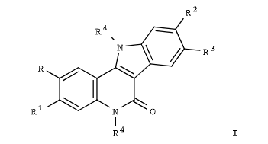
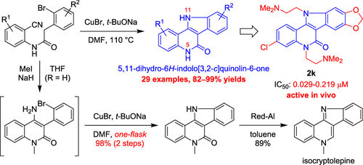
Copper(I)​-​Catalyzed Nitrile-​Addition​/N-​Arylation Ring-​Closure Cascade: Synthesis of 5,​11-​Dihydro-​6H-​indolo[3,​2-​c]​quinolin-​6-​ones as Potent Topoisomerase-​I Inhibitors
Jiann-Jyh Huang; National Chiayi University; Taiwan
lukehuang@mail.ncyu.edu.tw

